Slide 1

1
∞ Bagel run
You gain +3 strength in adjacent regions

Slide 2

2
Safe harbor
On your next turn you may play a card in a non-matching region

Slide 3
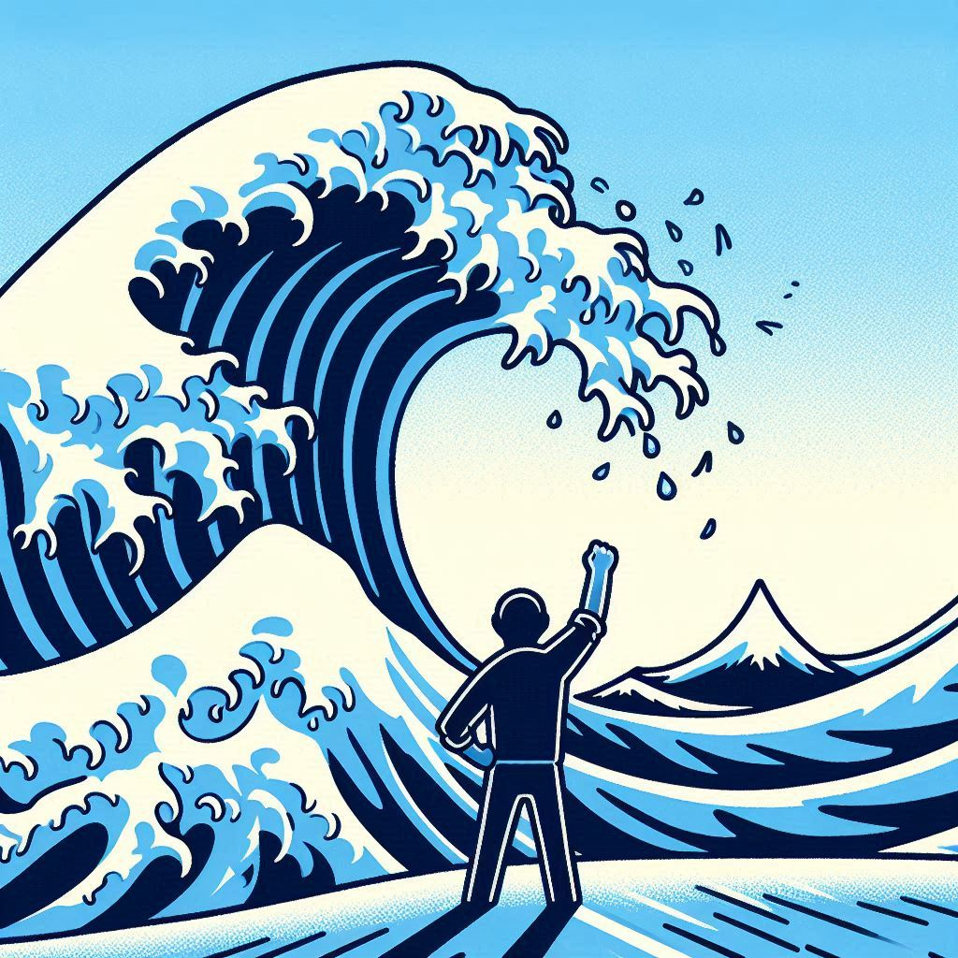
3
Turn the tide
Flip a card in an adjacent region

Slide 4

4
∞ West Egg
You may play cards of strength 3 or less to non-matching regions

Slide 5

5
∞ East Egg
If either player plays a card face-down, it’s immediately discarded

Slide 6

6
Clocktower

Slide 7

1
Shoreline
Draw a card and play it face-down in an adjacent region

Slide 8

2
Beachcomber
Flip a card in any region

Slide 9
3
Turn the tide
Flip a card in an adjacent region

Slide 10

4
∞ Barrier islands
Cards covered by this card are strength 4

Slide 11

5
Fire Island
Opponent flips one of their cards, then you flip one of yours

Slide 12

6
The Pencil

Slide 13
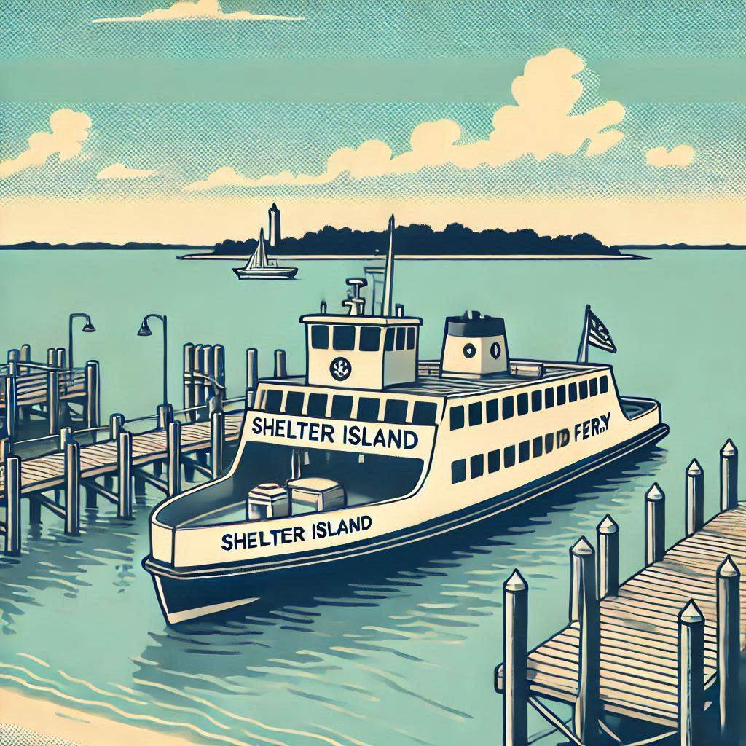
1
Ferry
You may move any one of your cards to
another region

Slide 14

2
∞ The End
All your face-down cards are strength 4

Slide 15
3
Turn the tide
Flip a card in an adjacent region

Slide 16

4
Hamptons retreat
You may return one of your face-down cards to your hand; if you do, take another turn

Slide 17

5
∞ Peconic bottleneck
If an adjacent region has total 3+ cards, any new cards played there are immediately discarded

Slide 18

6
Big duck

Slide 19

2
Paumanok

Slide 21
Player One
Wins ties
Cards left in hand
Points opponent scores if you withdraw
4+
2
2-3
3
1
4
0
6

Slide 22
Player Two
Loses ties
Cards left in hand
Points opponent scores if you withdraw
5+
2
3-4
3
2
4
0-1
6

Slide 23
How to play
Goal: Score 12 points to win the game.
Each round: Shuffle the deck and deal 6 cards to each player. Cycle regions in the middle. Swap Player One and Two. Player One starts the round.
On your turn: Play a card on your side face-up in its matching region and use its ability, or play it face-down in any region. Or, withdraw to forfeit the round.
Win the round: The player with the highest strength controls a region. Ties go to Player One. The player that controls the most regions wins the round and is awarded points.

Slide 24
How to play
Abilities: Card abilities take effect when played or flipped face-up.
Most abilities are instant, but some are ongoing (∞) while face-up.
You must perform a card’s ability if possible, unless it says “may.”
Covered: When a card is added to a region with existing cards, it overlaps (covers) the previous ones, showing only the top portion.
Flip: Only uncovered cards may be flipped. Unless stated otherwise, you may flip any card—yours or your opponent’s.

Slide 25
How to play
Non-matching region: As a result of abilities, cards may end up in a region that does not match their own. The card remains where it is and its strength counts towards that region.
Immediately discarded: Cards that are “immediately discarded” do not get to use their abilities.
Move: Some abilities allow you to “move” a card. Moving doesn’t count as playing, and does not trigger its ability again.

Slide 26
About Paumanok
Paumanok is a Native American name for Long Island, meaning “land of tribute” or “island that pays tribute.”
The gameplay draws inspiration from Air, Land & Sea, with players competing for control over three regions of the island, using unique abilities and strategic plays to outmaneuver their opponents.
Special thanks to Jon Perry for designing the original game, and to my sons, Oliver and Miles, for their imaginative input and enthusiasm on the card designs.

Slide 27

Gold Coast
Mansions & maritime
Gold Coast
Mansions & maritime

Slide 28
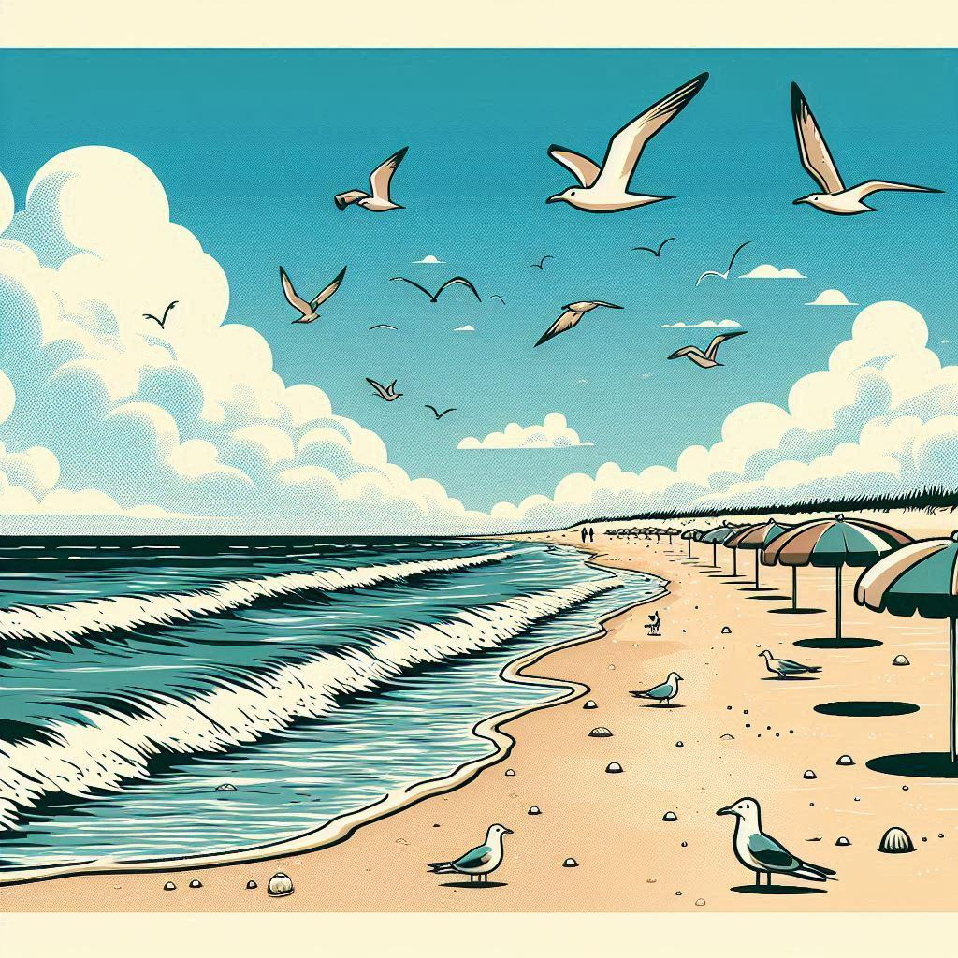
South Shore
Beaches & boardwalks
South Shore
Beaches & boardwalks

Slide 29

East end
Vineyards & vistas
East end
Vineyards & vistas

